Slide 1

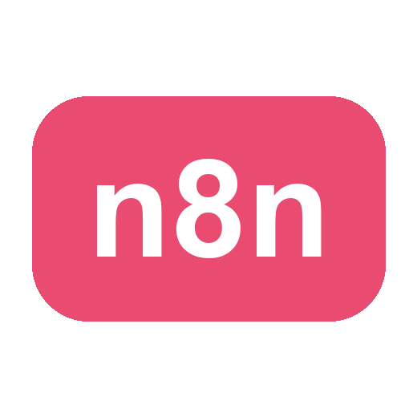
TERTIARY INFOTECH ACADEMY
VOICE
Voice and Video
Agents with n8n
n8n
AI
Agentic AI loop engineering for adult workplace training
VIDEO
REVIEW
C500 | v2.0 · 4 October 2026 | UEN: 201200696W
C500 - Voice and Video Agents with n8n
Copyright 2026 Tertiary Infotech Academy Pte Ltd
001

Slide 2
YOUR TRAINER
About the Trainer
?
<< Trainer Name >>
<< Qualification >> · << Years of experience >>
<< Industry practice >>
<< Teaching experience >>
<< Specialisation >>
General trainer template
C500 - Voice and Video Agents with n8n
Copyright 2026 Tertiary Infotech Academy Pte Ltd
002

Slide 3
YOUR TRAINER
About the Trainer
AA
Dr Alfred Ang
PhD · ACTA / ACLP certified adult educator
Founder, Tertiary Infotech Academy
AI automation, voice and video agents
n8n, RAG, LLM systems in production
Your trainer today
C500 - Voice and Video Agents with n8n
Copyright 2026 Tertiary Infotech Academy Pte Ltd
003

Slide 4
NOW YOU - INTRODUCE YOURSELF
Let's Get to Know Each Other
One minute each. The trainer just introduced himself - your turn.
1
Your name and role
And the organisation or team you work with
2
Your automation experience
n8n, chatbots, voice or video AI - or none at all, which is fine
3
Why you are here
The one thing you want to automate after these two days
4
One fun fact
Optional - break the ice
You will be demoing your builds to each other for two days - start talking now.
C500 - Voice and Video Agents with n8n
Copyright 2026 Tertiary Infotech Academy Pte Ltd
004

Slide 5
HOUSEKEEPING
Ground Rules
1
Be on time
Sessions start at 9:30am sharp
2
Phones on silent
Take calls outside the room
3
Ask as you go
A question now saves an hour later
4
Work the labs
70% of this course is hands-on
5
Respect the room
One conversation at a time
C500 - Voice and Video Agents with n8n
Copyright 2026 Tertiary Infotech Academy Pte Ltd
005

Slide 6
HOW THE DAYS RUN
Lesson Plan - 2 Days
9:30am - 5:30pm · 30-minute lunch · 7.5 instructional hours a day
Day 1 · Morning
Labs 0-3: local stack, first agent, RAG chatbot, CX advisor
Topic 1 - Chatbot
Day 1 · Afternoon
Labs 4-5: ElevenLabs booking agent, Vapi FAQ agent
Topic 2 - Voice Agent
Day 2 · Morning
Labs 6-10: lip-sync, news avatars, interactive avatars, Veo 3
Topic 3 - Video Agent
Day 2 · Afternoon
Evidence check, review and course feedback
Topic 3 continues + review
C500 - Voice and Video Agents with n8n
Copyright 2026 Tertiary Infotech Academy Pte Ltd
006

Slide 7
BEFORE WE START
Download Your Course Material
Everything - slides, Learner Guide, lab files - is on the LMS.
1
Go to
lms-tms.tertiaryinfotech.com
2
Sign in
Use the email you registered with
3
Open the course
Voice and Video Agents with n8n
4
Download
Learner Slides (PDF), Learner Guide (PDF), lab files
lms-tms.tertiaryinfotech.com
C500 - Voice and Video Agents with n8n
Copyright 2026 Tertiary Infotech Academy Pte Ltd
007

Slide 8
GET THE LAB FILES
Download the Labs from GitHub
Every lab - the n8n flows, the websites, the PDFs, the launchers - is one public repository.
github.com/tertiarycourses/C500-Voice-and-Video-Agents-with-n8n
1
Open the repository
Scan the link above, or search 'tertiarycourses' on GitHub
2
Code -> Download ZIP
Or, if you use git: git clone github.com/tertiarycourses/C500-Voice-and-Video-Agents-with-n8n
3
Windows: Unblock the ZIP
Right-click the ZIP -> Properties -> tick Unblock -> OK, THEN extract
4
Open labs_local_n8n/
The local build used in class - each lab folder has the flow JSON + website
Cannot run Docker? labs_remote_n8n/ is the same ten labs on the hosted n8n - ask the trainer.
C500 - Voice and Video Agents with n8n
Copyright 2026 Tertiary Infotech Academy Pte Ltd
008

Slide 9
COURSE OUTCOMES
What You Will Be Able to Build
1
LOCAL AI
2
RAG
3
VOICE
n8n agents powered by Ollama
Evidence-grounded workplace answers
Secure browser-to-agent handoffs
4
VIDEO
5
OPERATIONS
Avatar and cinematic automation
Tests, guardrails, review and recovery
The course ends with an integrated, reviewable AI workforce capstone.
C500 - Voice and Video Agents with n8n
Copyright 2026 Tertiary Infotech Academy Pte Ltd
009

Slide 10
ENVIRONMENT
Set Up Your Machine - macOS or Windows
Every lab runs on both. The tools are identical; only the install command and a little typing differ.
macOS - Terminal + Homebrew (brew.sh)
Windows - PowerShell + winget (built in)
Docker Desktop
brew install --cask docker
winget install Docker.DockerDesktop
Ollama
brew install ollama
winget install Ollama.Ollama
Python 3
already installed (python3)
winget install Python.Python.3.12
ffmpeg
brew install ffmpeg
winget install Gyan.FFmpeg
ngrok (Labs 4-5)
brew install ngrok
winget install ngrok.ngrok
WINDOWS GOTCHAS
Reopen PowerShell after installing, or the command is 'not recognized' · Docker needs WSL 2 (wsl --install) · The command is python, NOT python3
C500 - Voice and Video Agents with n8n
Copyright 2026 Tertiary Infotech Academy Pte Ltd
010

Slide 11
ENGINEERING METHOD
The Agentic AI Loop
1
2
3
4
5
6
7
DEFINE
BUILD
OBSERVE
EVALUATE
IMPROVE
GUARDRAIL
DOCUMENT
Outcome + risk
Smallest proof
Trace behavior
Test rubric
One variable
Control action
Make repeatable
Learner habit
Show the input, trace, output, evaluation decision, and the next revision.
C500 - Voice and Video Agents with n8n
Copyright 2026 Tertiary Infotech Academy Pte Ltd
011

Slide 12
TOPIC 01
Topic 01 - Chatbot
01
Agents, retrieval and grounded answers: your first n8n AI agent, a RAG chatbot that admits what it does not know, and a customer-facing course advisor on a real website. Labs 0-3.
LEARNING ARC
Concept
1
2
3
4
5
6
7
Practice
Define
Build
Observe
Evaluate
Improve
Guardrail
Document
Evidence
Reflection
Every lab produces visible evidence for trainer review.
C500 - Voice and Video Agents with n8n
Copyright 2026 Tertiary Infotech Academy Pte Ltd
012

Slide 13
RAG - THE PROBLEM
Why RAG? The Model Has Never Seen Your Documents
WITHOUT RAG
WITH RAG
“What is the refund policy?”
The workflow silently rewrites the question:
The model was never trained on your handbook.
It does not say “I don't know”.
“Using ONLY these passages from the handbook:
<retrieved chunk 1>
<retrieved chunk 2>
answer: what is the refund policy?
If they do not contain the answer, say you do not know.”
“Refunds are accepted within 30 days…”
Fluent. Confident. Invented.
This failure is called HALLUCINATION.
The model stops being a SOURCE of facts
and becomes a READER of facts you supply.
C500 - Voice and Video Agents with n8n
Copyright 2026 Tertiary Infotech Academy Pte Ltd
013

Slide 14
RAG - ARCHITECTURE
RAG Has Two Phases
Everything below exists to answer ONE question: which passages do we paste in front of the user's question?
1
INDEXING
runs ONCE, when a document is uploaded
PDF
Split into
chunks
Embed each
chunk
768-dim
vectors
Vector
store
>
>
>
>
2
RETRIEVAL
runs on EVERY question
Question
Embed the
question
Cosine
similarity
Top-k
chunks
Grounded
answer
>
>
>
>
On the n8n canvas these are the two visible paths: the upload path ending at the vector store, and the chat path reading from it.
C500 - Voice and Video Agents with n8n
Copyright 2026 Tertiary Infotech Academy Pte Ltd
014

Slide 15
RAG - TOKENS
Tokenization: How Text Becomes Numbers
Models do not read words. They read TOKENS - the sub-word units in the model's vocabulary.
“The salon is closed on Sundays.”
The
salon
is
closed
on
Sund
ays
.
8 tokens · note that “Sundays” split into TWO
RULE OF THUMB (English): 1 token ≈ 4 characters ≈ 0.75 of a word → 1,000 tokens ≈ 750 words ≈ 1.5 pages
CONTEXT WINDOW
COST + LATENCY
CHUNK SIZE
System prompt, retrieved chunks, memory and the question all compete for the SAME token budget.
Double the retrieved text and you roughly double the prompt cost of every call.
Chunks are measured in tokens. This is the number you tune in Lab 2.4.
C500 - Voice and Video Agents with n8n
Copyright 2026 Tertiary Infotech Academy Pte Ltd
015

Slide 16
RAG - EMBEDDINGS
Embeddings: Meaning as Coordinates
An embedding turns ANY text into a fixed-length vector. Here: nomic-embed-text (Ollama) → 768 numbers.
“How do I reset my password?”
>
[ 0.021, -0.118, 0.334, … ] 768 numbers
Texts with similar MEANING land close together - even with zero words in common.
“reset my password” vs “I forgot my login credentials”
0.89
NEAR - no shared words, same meaning
“reset my password” vs “what are your opening hours?”
0.11
FAR - unrelated
Cosine similarity: 1.0 = same direction/meaning · 0.0 = unrelated · -1.0 = opposite. Retrieval returns the top-k nearest chunks (k is usually 3-5).
TWO RULES THAT CAUSE REAL BUGS: Questions and documents MUST use the same embedding model · A vector store answers only “what is near this vector?” - not SQL
C500 - Voice and Video Agents with n8n
Copyright 2026 Tertiary Infotech Academy Pte Ltd
016

Slide 17
RAG - CHUNKING
Chunking: The Trade-off You Must Measure
You cannot embed a 40-page PDF as one vector - the detail would be averaged away. So documents are split into chunks (e.g. 800 characters) with an overlap (e.g. 100) so a sentence cut in half still appears whole somewhere.
CHUNKS TOO SMALL
CHUNKS TOO LARGE
•
Retrieved passage lacks context
•
Answer arrives with 3 irrelevant sections
•
The model sees half an answer
•
The model gets distracted, cites the wrong part
•
High precision, low recall
•
High recall, low precision
•
“The document does not say” - when it does
•
Tokens - and money - are wasted
There is no universally correct value.
That is why Lab 2.4 MEASURES it with golden questions instead of guessing. And when an answer is wrong: read the RETRIEVED CHUNKS first - if the right chunk never came back, no prompt rewrite will save it.
C500 - Voice and Video Agents with n8n
Copyright 2026 Tertiary Infotech Academy Pte Ltd
017

Slide 18
BUILD TARGET
Lab 0: Set Up n8n Locally
T
TIMEBOX
0
YOU WILL BUILD
A working local stack: Docker running n8n and Postgres, Ollama serving gemma4 and nomic-embed-text, all talking to each other.
45 minutes
M
MODE
Demo, guided build, independent test
DELIVERABLE
A running local stack: screenshots of docker compose ps, ollama list and the passing credential test.
EVIDENCE
E
Execution trace plus learner artifact
Success is demonstrated, not assumed.
C500 - Voice and Video Agents with n8n
Copyright 2026 Tertiary Infotech Academy Pte Ltd
018

Slide 19
CONCEPT MAP
Lab 0: Four Ideas That Make It Work
1
Docker Compose
2
Ollama
One file starts n8n and Postgres as a repeatable local stack.
Runs the chat model (gemma4) and the embedding model on your machine - free, offline, private.
3
host.docker.internal
4
The Active rule
How n8n inside a container reaches Ollama on the host. Inside the container, localhost means the container itself.
A production /webhook/ path exists only when a workflow is switched Active. Inactive means 404, every time.
Connect the four ideas before touching the workflow canvas.
C500 - Voice and Video Agents with n8n
Copyright 2026 Tertiary Infotech Academy Pte Ltd
019

Slide 20
WORKFLOW PLAN
Lab 0: Build Sequence
1
Install Docker Desktop and Ollama (macOS: brew, Windows: winget), then launch Docker and wait for the whale to settle.
2
From labs_local_n8n/lab0, run docker compose pull, then docker compose up -d, and confirm both containers with docker compose ps.
3
Pull the two models: ollama pull gemma4 and ollama pull nomic-embed-text, then confirm both appear in ollama list.
4
Open http://localhost:5678 and create the n8n owner account. It is local only, and there is no password reset - write it down.
5
Create an Ollama credential named Ollama local with base URL http://host.docker.internal:11434, and press Test.
6
Learn the everyday commands: docker compose stop to pause, up -d to resume - and never down -v unless you mean to erase every workflow you own.
Build one observable behavior at a time.
C500 - Voice and Video Agents with n8n
Copyright 2026 Tertiary Infotech Academy Pte Ltd
020

Slide 21
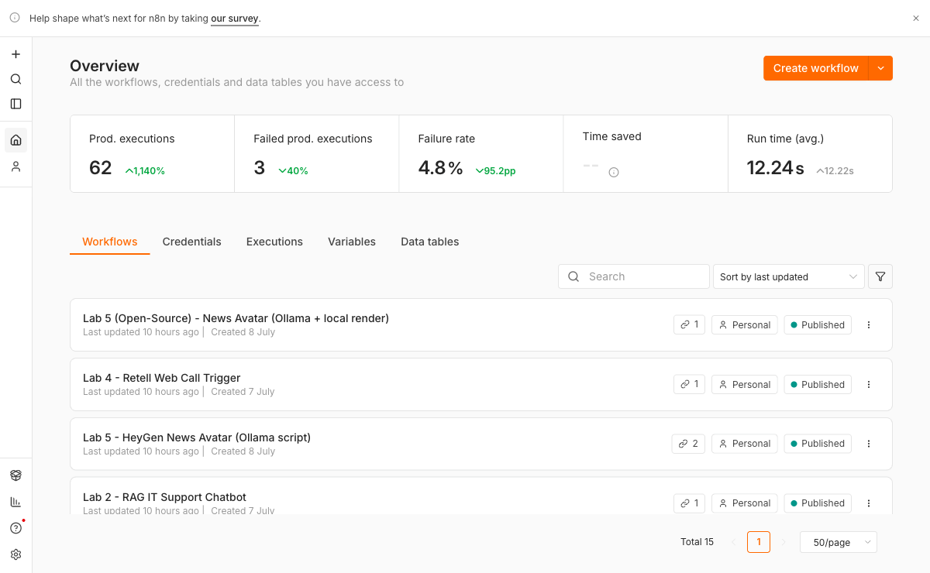
LAB 0 - SET UP N8N LOCALLY
The course workflows imported into local n8n.
The course workflows imported into local n8n.
C500 - Voice and Video Agents with n8n
Copyright 2026 Tertiary Infotech Academy Pte Ltd
021

Slide 22
QUALITY GATE
Lab 0: Prove, Evaluate, Improve
OK
docker compose ps shows the n8n and postgres containers running.
EVIDENCE STACK
01
Input
Exact test payload
OK
n8n opens at http://localhost:5678 and ollama list shows both models.
02
Trace
Node execution path
OK
The Ollama local credential test passes.
03
Output
Generated result
OK
You can explain why the credential must not use localhost:11434.
04
Decision
Rubric and revision
OK
Run one edge case and record the change made after evaluation.
PASS
C500 - Voice and Video Agents with n8n
Copyright 2026 Tertiary Infotech Academy Pte Ltd
022

Slide 23
TROUBLESHOOTING
Lab 0: Diagnose Before Rebuilding
SYMPTOM
LIKELY CAUSE
TARGETED FIX
n8n cannot connect to Ollama
The credential uses localhost from inside Docker.
Use http://host.docker.internal:11434.
Command not recognized (Windows)
PowerShell was already open during the install.
Close and reopen PowerShell - a new program is not on your PATH until you do.
Port 5678 is busy
An older n8n container is still running.
Run docker ps, stop the old container, or change the compose port.
Change one variable, rerun the same test, compare the trace.
C500 - Voice and Video Agents with n8n
Copyright 2026 Tertiary Infotech Academy Pte Ltd
023

Slide 24
BUILD TARGET
Lab 1: Your First AI Agent
T
TIMEBOX
1
YOU WILL BUILD
The smallest possible working agent: chat trigger, AI Agent node, and local gemma4 - with a system prompt you control.
45 minutes
M
MODE
Demo, guided build, independent test
DELIVERABLE
A working local agent plus a one-line note on how the system prompt changed its behaviour.
EVIDENCE
E
Execution trace plus learner artifact
Success is demonstrated, not assumed.
C500 - Voice and Video Agents with n8n
Copyright 2026 Tertiary Infotech Academy Pte Ltd
024

Slide 25
CONCEPT MAP
Lab 1: Four Ideas That Make It Work
1
Chat trigger
2
AI Agent node
n8n's built-in chat window - a test surface with no website needed.
Holds the system prompt, the memory and, later, the tools.
3
System prompt
4
Execution trace
The standing instruction that shapes every reply - your main control surface.
What the model actually received and returned. A fluent answer is not evidence; the trace is.
Connect the four ideas before touching the workflow canvas.
C500 - Voice and Video Agents with n8n
Copyright 2026 Tertiary Infotech Academy Pte Ltd
025

Slide 26
WORKFLOW PLAN
Lab 1: Build Sequence
1
Import lab1/ai-agent.json. Open the Ollama Chat Model node and confirm the credential is Ollama local and the model is gemma4:latest.
2
Click Chat at the bottom of the canvas and say hello. Confirm a reply arrives.
3
Open the execution and read exactly what the model received - the whole prompt, not just your message.
4
Open the AI Agent node and set a system prompt: 'You are a terse assistant. Never use more than two sentences.'
5
Ask the same question again and watch the behaviour change.
6
Change one more instruction and re-test. One variable at a time - that habit is the course.
Build one observable behavior at a time.
C500 - Voice and Video Agents with n8n
Copyright 2026 Tertiary Infotech Academy Pte Ltd
026

Slide 27
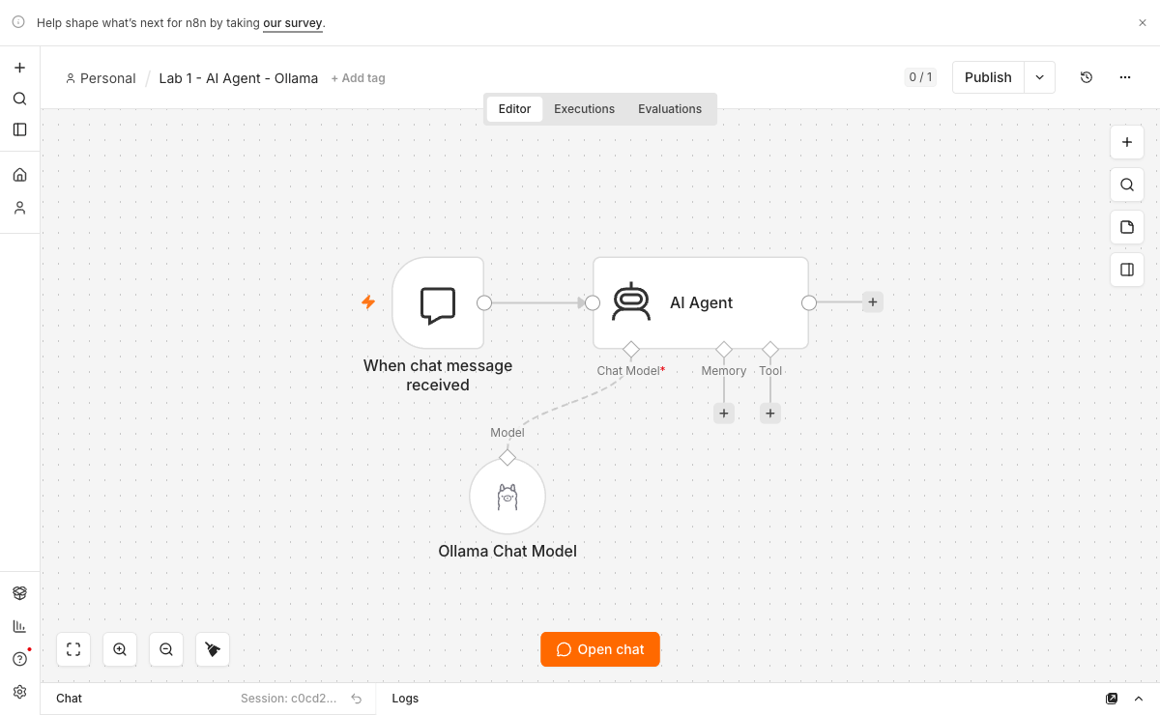
LAB 1 - YOUR FIRST AI AGENT
Lab 1 - AI Agent
Lab 1 - AI Agent: chat trigger, AI Agent and the local Ollama model.
C500 - Voice and Video Agents with n8n
Copyright 2026 Tertiary Infotech Academy Pte Ltd
027

Slide 28
QUALITY GATE
Lab 1: Prove, Evaluate, Improve
OK
The agent replies in the chat panel.
EVIDENCE STACK
01
Input
Exact test payload
OK
The execution list shows the run, and you can read what the model received.
02
Trace
Node execution path
OK
Changing the system prompt visibly changes the behaviour.
03
Output
Generated result
OK
Run one edge case and record the change made after evaluation.
04
Decision
Rubric and revision
PASS
C500 - Voice and Video Agents with n8n
Copyright 2026 Tertiary Infotech Academy Pte Ltd
028

Slide 29
TROUBLESHOOTING
Lab 1: Diagnose Before Rebuilding
SYMPTOM
LIKELY CAUSE
TARGETED FIX
Empty reply
The model name does not match what ollama list shows.
Select the exact tag, e.g. gemma4:latest.
Connection refused
Ollama is not running, or the base URL is wrong.
Start Ollama and use host.docker.internal:11434 in the credential.
The first reply is very slow
A 9-GB model is cold-loading into memory.
Expected once per session - later replies are fast.
Change one variable, rerun the same test, compare the trace.
C500 - Voice and Video Agents with n8n
Copyright 2026 Tertiary Infotech Academy Pte Ltd
029

Slide 30
BUILD TARGET
Lab 2: RAG IT Support Chatbot
T
TIMEBOX
2
YOU WILL BUILD
A chatbot that answers only from an uploaded IT FAQ PDF - and admits it when the answer is not in the document.
60 minutes
M
MODE
Demo, guided build, independent test
DELIVERABLE
A RAG chatbot answering from the IT FAQ, plus one provoked refusal captured in the execution trace.
EVIDENCE
E
Execution trace plus learner artifact
Success is demonstrated, not assumed.
C500 - Voice and Video Agents with n8n
Copyright 2026 Tertiary Infotech Academy Pte Ltd
030

Slide 31
CONCEPT MAP
Lab 2: Four Ideas That Make It Work
1
Ingest
2
Retrieve
Split the PDF into chunks, embed each chunk with nomic-embed-text, store the vectors.
Embed the question the same way and fetch the nearest chunks - search by meaning, not keywords.
3
Grounded generation
4
The refusal
gemma4 answers ONLY from the retrieved chunks, or says it does not know.
A question outside the PDF must get an honest refusal, not an invention. This is the graded behaviour.
Connect the four ideas before touching the workflow canvas.
C500 - Voice and Video Agents with n8n
Copyright 2026 Tertiary Infotech Academy Pte Ltd
031

Slide 32
WORKFLOW PLAN
Lab 2: Build Sequence
1
Import lab2/rag-flow.json and set it Active - both webhooks (/rag-upload, /rag-chat) exist only while it is Active.
2
Serve the page: from labs_local_n8n/lab2, run python3 -m http.server 8092 (Windows: python).
3
Open http://localhost:8092 - never by double-clicking index.html - and upload it-faq.pdf. Wait for the confirmation.
4
Ask a question the FAQ answers, and check the reply against the PDF.
5
Ask a question it does NOT answer - 'What is the CEO's salary?' - and demand a refusal.
6
Open the execution and read the retrieved chunks for both questions. If the right chunk never came back, no prompt rewrite will fix the answer.
Build one observable behavior at a time.
C500 - Voice and Video Agents with n8n
Copyright 2026 Tertiary Infotech Academy Pte Ltd
032

Slide 33
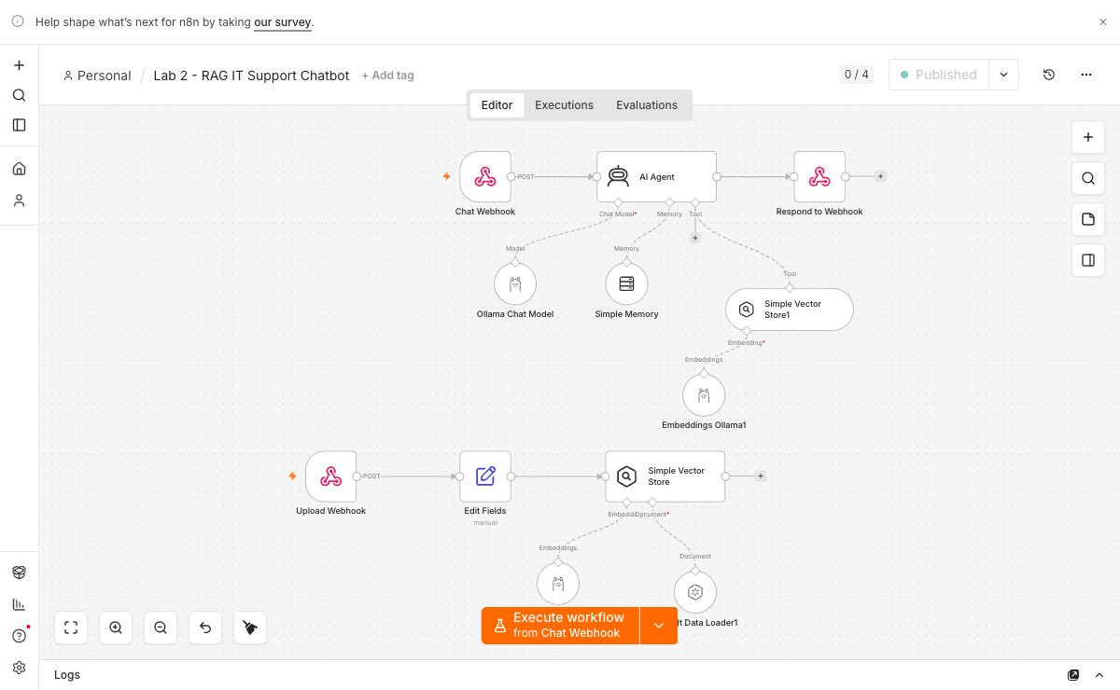
LAB 2 - RAG IT SUPPORT CHATBOT
Lab 2 - RAG IT Support Chatbot
Lab 2 - RAG IT Support Chatbot: ingestion, embeddings and the vector store.
C500 - Voice and Video Agents with n8n
Copyright 2026 Tertiary Infotech Academy Pte Ltd
033

Slide 34
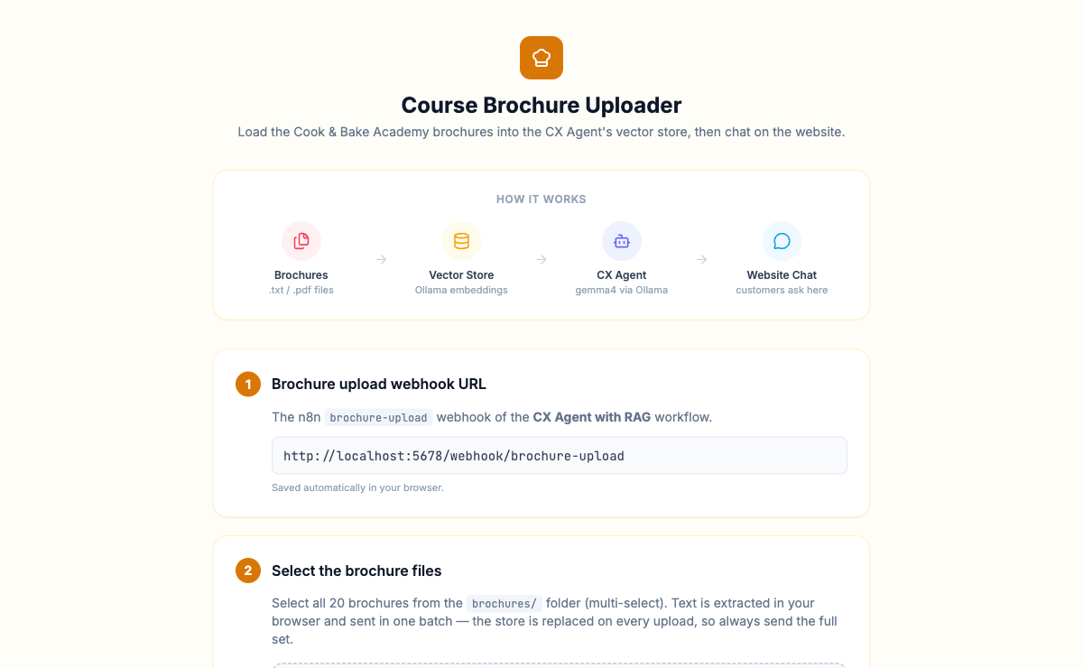
LAB 2 - RAG IT SUPPORT CHATBOT
The Lab 2 upload page
The Lab 2 upload page: the learner pastes their OWN n8n webhook URL.
C500 - Voice and Video Agents with n8n
Copyright 2026 Tertiary Infotech Academy Pte Ltd
034

Slide 35
QUALITY GATE
Lab 2: Prove, Evaluate, Improve
OK
A question covered by the PDF gets a grounded, correct answer.
EVIDENCE STACK
01
Input
Exact test payload
OK
A question not covered gets a refusal, not an invention.
02
Trace
Node execution path
OK
You can point to the retrieved chunks in the execution trace.
03
Output
Generated result
OK
Run one edge case and record the change made after evaluation.
04
Decision
Rubric and revision
PASS
C500 - Voice and Video Agents with n8n
Copyright 2026 Tertiary Infotech Academy Pte Ltd
035

Slide 36
TROUBLESHOOTING
Lab 2: Diagnose Before Rebuilding
SYMPTOM
LIKELY CAUSE
TARGETED FIX
Every button dies silently
The page was opened from file://.
Serve it over http://localhost - the browser blocks fetch() on file URLs.
The website cannot reach n8n
The workflow is not Active.
Activate it - the production /webhook/ path does not exist until you do.
Answers are wrong or missing
The right chunk was never retrieved.
Read the retrieved chunks first; fix chunking or top-k, not the prompt.
Change one variable, rerun the same test, compare the trace.
C500 - Voice and Video Agents with n8n
Copyright 2026 Tertiary Infotech Academy Pte Ltd
036

Slide 37
BUILD TARGET
Lab 3: CX Agent with RAG (Cook & Bake Academy)
T
TIMEBOX
3
YOU WILL BUILD
A customer-facing course advisor: a chat widget on a real-looking school website, grounded in the school's own course brochures.
60 minutes
M
MODE
Demo, guided build, independent test
DELIVERABLE
A working course-advisory chatbot on the site, with one grounded answer and one honest refusal in the trace.
EVIDENCE
E
Execution trace plus learner artifact
Success is demonstrated, not assumed.
C500 - Voice and Video Agents with n8n
Copyright 2026 Tertiary Infotech Academy Pte Ltd
037

Slide 38
CONCEPT MAP
Lab 3: Four Ideas That Make It Work
1
Brochure knowledge base
2
Customer tone
The vector store is filled from real course brochures - the agent speaks for a business, not a toy FAQ.
A CX agent answers as the business: specific courses, prices, schedules and next steps.
3
Conversation memory
4
Honest limits
A follow-up like 'how much is that one?' must resolve against the previous turn.
Asked about a course that does not exist, the agent says so. No invented courses, no invented prices.
Connect the four ideas before touching the workflow canvas.
C500 - Voice and Video Agents with n8n
Copyright 2026 Tertiary Infotech Academy Pte Ltd
038

Slide 39
WORKFLOW PLAN
Lab 3: Build Sequence
1
Import lab3/CX Agent with RAG.json and set it Active.
2
Open lab3/upload-brochures.html and upload the PDFs from lab3/brochures/ - this fills the vector store through /brochure-upload.
3
Serve the site: from labs_local_n8n/lab3/website, run python3 -m http.server 8093, and open the chat widget.
4
Ask about a course, its price and its schedule - and check every answer against a brochure.
5
Ask a follow-up that needs memory: 'how much is that one?'
6
Ask for a course that does not exist, and confirm the agent admits it rather than inventing one.
Build one observable behavior at a time.
C500 - Voice and Video Agents with n8n
Copyright 2026 Tertiary Infotech Academy Pte Ltd
039

Slide 40
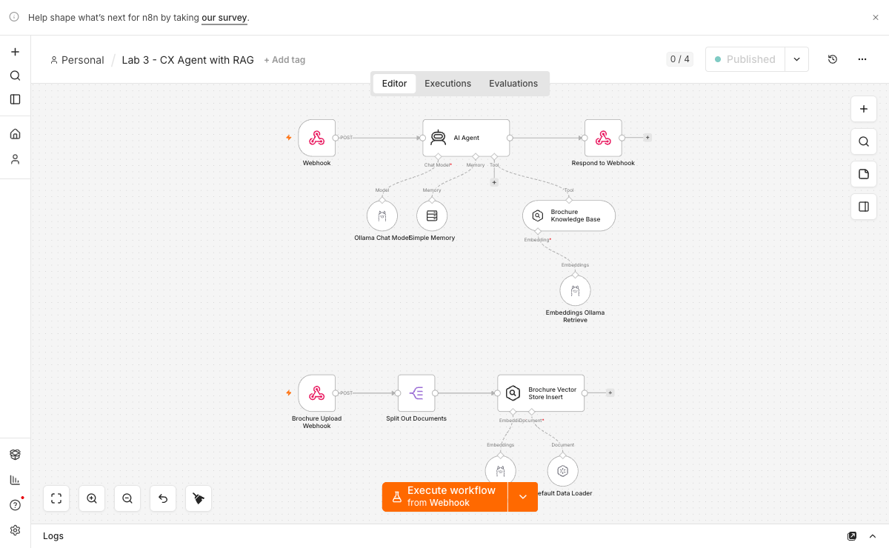
LAB 3 - CX AGENT WITH RAG (COOK & BAKE ACADEMY)
Lab 3 - CX Agent with RAG
Lab 3 - CX Agent with RAG: the agent plus its retrieval tool.
C500 - Voice and Video Agents with n8n
Copyright 2026 Tertiary Infotech Academy Pte Ltd
040

Slide 41

LAB 3 - CX AGENT WITH RAG (COOK & BAKE ACADEMY)
Lab 3 - Cook & Bake Academy site
Lab 3 - Cook & Bake Academy site: the customer-facing front end.
C500 - Voice and Video Agents with n8n
Copyright 2026 Tertiary Infotech Academy Pte Ltd
041

Slide 42

LAB 3 - CX AGENT WITH RAG (COOK & BAKE ACADEMY)
Lab 3 - the chat widget's gear
Lab 3 - the chat widget's gear: each learner points it at their own n8n webhook.
C500 - Voice and Video Agents with n8n
Copyright 2026 Tertiary Infotech Academy Pte Ltd
042

Slide 43
QUALITY GATE
Lab 3: Prove, Evaluate, Improve
OK
The agent answers from the brochures, with specifics.
EVIDENCE STACK
01
Input
Exact test payload
OK
A non-existent course gets an honest 'we don't offer that'.
02
Trace
Node execution path
OK
The chat has memory - the follow-up resolves correctly.
03
Output
Generated result
OK
Run one edge case and record the change made after evaluation.
04
Decision
Rubric and revision
PASS
C500 - Voice and Video Agents with n8n
Copyright 2026 Tertiary Infotech Academy Pte Ltd
043

Slide 44
TROUBLESHOOTING
Lab 3: Diagnose Before Rebuilding
SYMPTOM
LIKELY CAUSE
TARGETED FIX
The widget cannot reach n8n
The workflow is inactive, or the webhook URL was changed.
Activate the flow - the widget already points at /webhook/cx-agent.
Vague answers, no prices
The brochures were never uploaded.
Run upload-brochures.html first and watch the upload executions succeed.
Follow-ups lose the thread
Memory is not wired into the agent.
Check the memory node and its session key in the workflow.
Change one variable, rerun the same test, compare the trace.
C500 - Voice and Video Agents with n8n
Copyright 2026 Tertiary Infotech Academy Pte Ltd
044

Slide 45
TOPIC 02
Topic 02 - Voice Agent
02
Two vendors, two architectures: ElevenLabs runs the model and calls your n8n tools; with Vapi your n8n workflow IS the model. The contrast is the lesson. Labs 4-5.
LEARNING ARC
Concept
1
2
3
4
5
6
7
Practice
Define
Build
Observe
Evaluate
Improve
Guardrail
Document
Evidence
Reflection
Every lab produces visible evidence for trainer review.
C500 - Voice and Video Agents with n8n
Copyright 2026 Tertiary Infotech Academy Pte Ltd
045

Slide 46
VOICE - THE CONTRAST IS THE LESSON
Two Vendors, Two Architectures
ELEVENLABS - LAB 4 (GG HAIR SALON)
VAPI - LAB 5 (MEDIREFILL)
Who runs the model
ElevenLabs
Who runs the model
YOUR n8n workflow (Custom LLM)
What n8n does
mints a signed URL, serves the tools
What n8n does
IS the brain - and the guardrail
Call path
browser -> n8n -> signed URL -> WebSocket
Call path
browser -> Vapi, then Vapi -> your n8n
Browser receives
a short-lived SIGNED URL
Browser receives
the Vapi PUBLIC key only
Browser never sees
your xi-api-key
Browser never sees
your Vapi private key
Either way, the browser only ever holds a short-lived, single-purpose token - never a vendor key.
C500 - Voice and Video Agents with n8n
Copyright 2026 Tertiary Infotech Academy Pte Ltd
046

Slide 47
TUNNEL - THE PROBLEM
Why localhost Stops Working
In Labs 4 and 5 something OUTSIDE your machine calls INTO n8n for the first time.
WORKS - your own browser
FAILS - ElevenLabs / Vapi servers
Labs 1-3 · Book by Voice · curl
check_availability · book_appointment · Custom LLM
Your browser and n8n are on the SAME machine,
so http://localhost:5678 resolves correctly.
To a datacenter in another country, “localhost”
means ITS OWN machine. The request never
leaves their building.
No tunnel needed. Do not change this.
Tunnel required.
THE SYMPTOM YOU WILL ACTUALLY SEE
Nina says “let me check that for you” … then silence. Nothing appears in the n8n executions list, because the
request never arrived. That is not a prompt bug. It is a networking bug.
C500 - Voice and Video Agents with n8n
Copyright 2026 Tertiary Infotech Academy Pte Ltd
047

Slide 48
TUNNEL - SETUP
Expose n8n With ngrok
1
Install
brew install ngrok
(Windows: ngrok.com/download)
2
Authtoken
Free signup, then:
ngrok config add-authtoken <TOKEN>
3
Start it
ngrok http 5678
Leave this window OPEN all session
4
Read the URL
Forwarding https://<id>.ngrok-free.app
-> http://localhost:5678
5
Inspect
http://127.0.0.1:4040 <- bookmark this
Status tab = your public URL. Inspect tab = every request as it arrives.
Prove it with curl BEFORE touching the voice platform - HTTP is far easier to debug than audio.
C500 - Voice and Video Agents with n8n
Copyright 2026 Tertiary Infotech Academy Pte Ltd
048

Slide 49
TUNNEL - THE URL
Building the URL You Paste Into the Vendor
You are gluing two halves together: ngrok supplies the address, the n8n Webhook node supplies the path.
https://3af5-…ngrok-free.app
/webhook/check-availability
from ngrok
from the n8n Webhook node
THE RULE: take the node's PRODUCTION URL and swap http://localhost:5678 for your ngrok address.
!
The free URL changes on every restart
Re-paste it and PUBLISH the agent again
!
Test URL instead of Production URL
Use /webhook/ - never /webhook-test/
!
Workflow not published
404 'not registered' - publish, then retest
!
Setting WEBHOOK_URL on the container
Do NOT. It breaks localhost for Labs 1-3
C500 - Voice and Video Agents with n8n
Copyright 2026 Tertiary Infotech Academy Pte Ltd
049

Slide 50
BUILD TARGET
Lab 4: Voice Booking Agent with ElevenLabs (GG Hair Salon)
T
TIMEBOX
4
YOU WILL BUILD
Nina, a voice receptionist who answers by voice, checks a real Google Calendar for free slots, and books a real appointment.
120 minutes
M
MODE
Demo, guided build, independent test
DELIVERABLE
A real calendar booking made by voice: the calendar event, the call transcript, and the n8n tool execution.
EVIDENCE
E
Execution trace plus learner artifact
Success is demonstrated, not assumed.
C500 - Voice and Video Agents with n8n
Copyright 2026 Tertiary Infotech Academy Pte Ltd
050

Slide 51
CONCEPT MAP
Lab 4: Four Ideas That Make It Work
1
Signed URL
2
Agent tools
n8n asks ElevenLabs for a short-lived signed URL server-side, using the xi-api-key - the key never reaches the browser.
check_availability and book_appointment are n8n webhooks that ElevenLabs' SERVERS call during the conversation.
3
Call direction
4
Grounded voice
Browser-to-n8n needs no tunnel; ElevenLabs-to-n8n needs ngrok. Before debugging any webhook, ask: who is dialling?
The salon handbook PDF in the agent's Knowledge Base is why Nina quotes real prices instead of inventing them.
Connect the four ideas before touching the workflow canvas.
C500 - Voice and Video Agents with n8n
Copyright 2026 Tertiary Infotech Academy Pte Ltd
051

Slide 52
WORKFLOW PLAN
Lab 4: Build Sequence
1
Import BOTH flows - elevenlabs-web-call-flow.json and elevenlabs-booking-tools-flow.json - and set both Active.
2
On the Get Signed URL node, add a Header Auth credential named ElevenLabs API: name xi-api-key, value your key.
3
Connect YOUR OWN Google account on the two Google Calendar nodes - the flow ships without a calendar credential on purpose.
4
In the ElevenLabs dashboard, create the agent (Nina), upload knowledge-base/gg-hair-salon-handbook.pdf to her Knowledge Base, and put her agent ID into the page's Settings.
5
Start the tunnel with ngrok http 5678, and register the two tools in the agent as https://<id>.ngrok-free.app/webhook/check-availability and .../book-appointment.
6
Serve the site (python3 -m http.server 8090 from lab4/website), click Book by Voice, and book a Thursday 2 PM haircut end to end.
Build one observable behavior at a time.
C500 - Voice and Video Agents with n8n
Copyright 2026 Tertiary Infotech Academy Pte Ltd
052

Slide 53
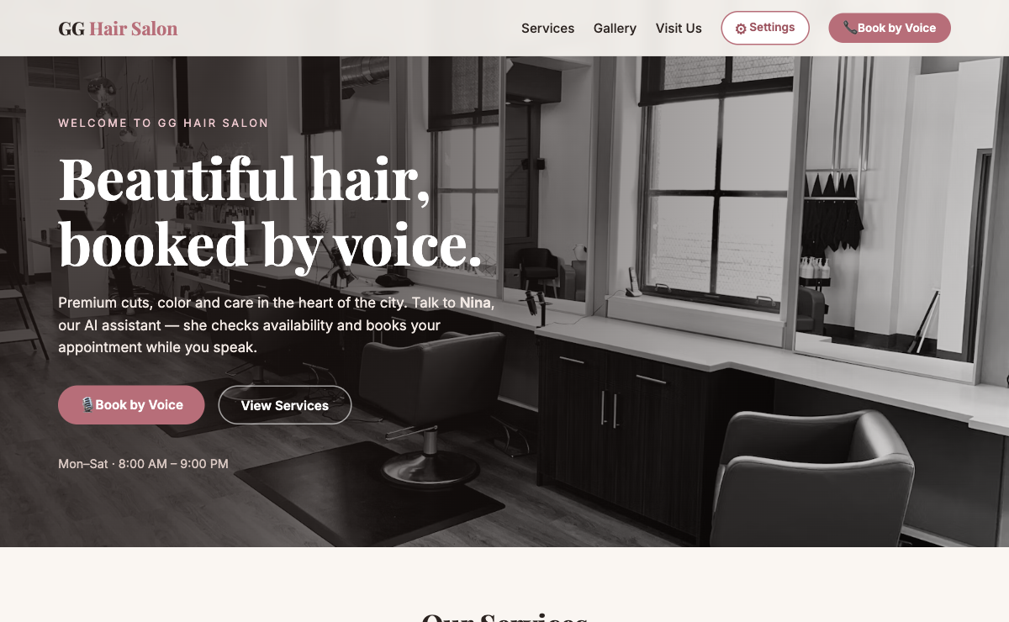
LAB 4 - VOICE BOOKING AGENT WITH ELEVENLABS (GG HAIR SALON)
Lab 4 - GG Hair Salon site
Lab 4 - GG Hair Salon site: the Book by Voice call to action.
C500 - Voice and Video Agents with n8n
Copyright 2026 Tertiary Infotech Academy Pte Ltd
053

Slide 54
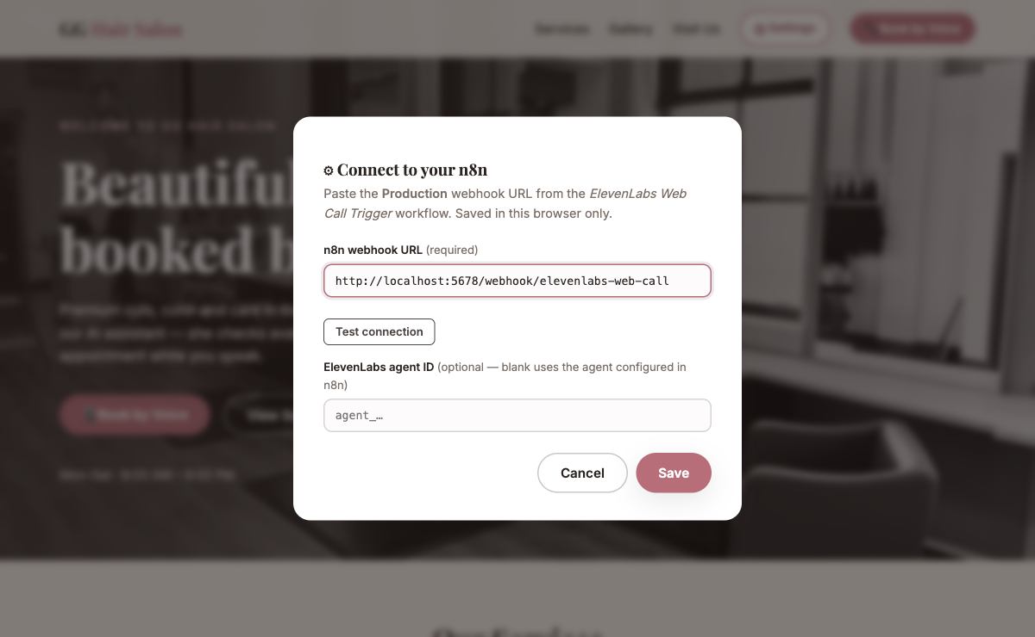
LAB 4 - VOICE BOOKING AGENT WITH ELEVENLABS (GG HAIR SALON)
Lab 4 - Settings
Lab 4 - Settings: the ElevenLabs Web Call Trigger webhook URL and optional agent ID. Nothing is hardcoded.
C500 - Voice and Video Agents with n8n
Copyright 2026 Tertiary Infotech Academy Pte Ltd
054

Slide 55
QUALITY GATE
Lab 4: Prove, Evaluate, Improve
OK
Nina answers by voice and quotes handbook prices.
EVIDENCE STACK
01
Input
Exact test payload
OK
Asked for a taken slot, she offers an alternative.
02
Trace
Node execution path
OK
The booking appears in YOUR Google Calendar - that event is the evidence.
03
Output
Generated result
OK
A tool execution appears in n8n DURING the call.
04
Decision
Rubric and revision
OK
Run one edge case and record the change made after evaluation.
PASS
C500 - Voice and Video Agents with n8n
Copyright 2026 Tertiary Infotech Academy Pte Ltd
055

Slide 56
TROUBLESHOOTING
Lab 4: Diagnose Before Rebuilding
SYMPTOM
LIKELY CAUSE
TARGETED FIX
Nina says 'let me check that' and stalls forever
Her tool call went to localhost, which ElevenLabs' servers cannot see.
Register the tools with your ngrok URL, and keep the tunnel window open all session.
The call never starts
The web-call flow is inactive, or the Settings URL is wrong.
Activate the flow and paste the PRODUCTION URL - /webhook/, never /webhook-test/.
She invents prices
The handbook is not attached to the agent.
Upload the PDF to the agent's Knowledge Base and save the agent again.
Change one variable, rerun the same test, compare the trace.
C500 - Voice and Video Agents with n8n
Copyright 2026 Tertiary Infotech Academy Pte Ltd
056

Slide 57
BUILD TARGET
Lab 5: Grounded FAQ Voice Agent with Vapi (MediRefill)
T
TIMEBOX
5
YOU WILL BUILD
Ava, a pharmacy refill assistant whose brain is YOUR n8n workflow - grounded in six FAQ topics and hard-refusing all medical advice.
90 minutes
M
MODE
Demo, guided build, independent test
DELIVERABLE
A live Vapi call transcript showing grounded answers, a hard medical refusal, and the emergency escalation.
EVIDENCE
E
Execution trace plus learner artifact
Success is demonstrated, not assumed.
C500 - Voice and Video Agents with n8n
Copyright 2026 Tertiary Infotech Academy Pte Ltd
057

Slide 58
CONCEPT MAP
Lab 5: Four Ideas That Make It Work
1
Custom LLM
2
Public vs private key
Vapi does speech-to-text and the voice, then calls your n8n webhook as its model. Here, n8n IS the brain.
The page gets the Vapi PUBLIC key only - it can merely start calls. The private key manages your account and never leaves the dashboard.
3
Grounding
4
The safety boundary
Ava answers only from the six FAQ topics in her prompt - delivery, refills, collection, payment.
Dose, interaction, substitution, symptom: one fixed refusal sentence and a pharmacist callback. Fixed wording in the prompt - never the model's judgement.
Connect the four ideas before touching the workflow canvas.
C500 - Voice and Video Agents with n8n
Copyright 2026 Tertiary Infotech Academy Pte Ltd
058

Slide 59
WORKFLOW PLAN
Lab 5: Build Sequence
1
Import lab5/vapi-faq-flow.json and set it Active. Read ava-assistant-prompt.md - the guardrail lives in its wording.
2
Start the tunnel: ngrok http 5678. Vapi's servers must reach your n8n; localhost is invisible to them.
3
Prove the webhook with curl BEFORE any audio: POST an OpenAI-shaped body to https://<id>.ngrok-free.app/webhook/vapi-faq and read a real answer back.
4
In Vapi, create an assistant whose model is that Custom LLM URL.
5
Serve the site (python3 -m http.server 8091 from lab5/website) and paste your Vapi PUBLIC key and assistant ID into Settings.
6
Run the graded calls: 'When will my refill arrive?', then 'Can I take two instead of one?', then 'I'm having chest pains.'
Build one observable behavior at a time.
C500 - Voice and Video Agents with n8n
Copyright 2026 Tertiary Infotech Academy Pte Ltd
059

Slide 60
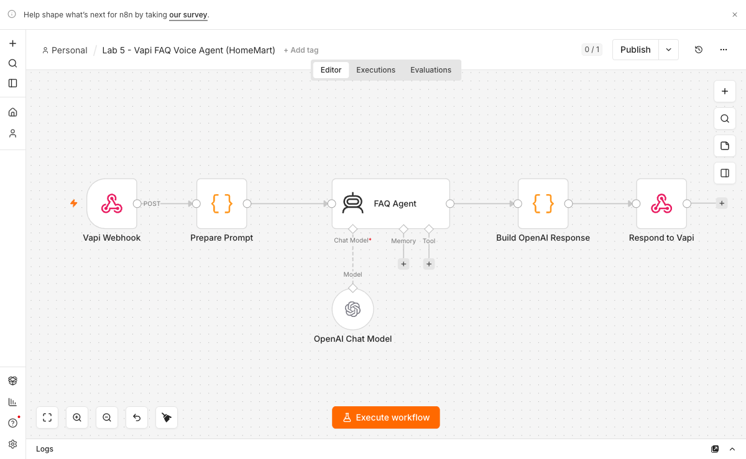
LAB 5 - GROUNDED FAQ VOICE AGENT WITH VAPI (MEDIREFILL)
Lab 5 - the Vapi custom-LLM flow
Lab 5 - the Vapi custom-LLM flow: webhook -> AI Agent (Ollama) -> OpenAI-shaped response.
C500 - Voice and Video Agents with n8n
Copyright 2026 Tertiary Infotech Academy Pte Ltd
060

Slide 61
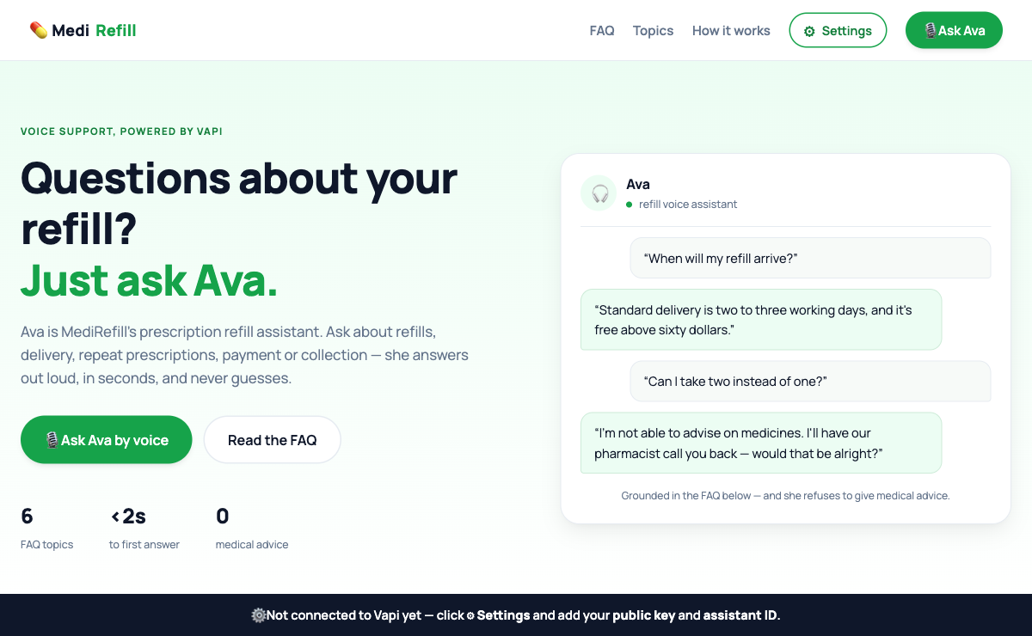
LAB 5 - GROUNDED FAQ VOICE AGENT WITH VAPI (MEDIREFILL)
Lab 5 - MediRefill
Lab 5 - MediRefill: Ava, the prescription-refill voice assistant, built on the Vapi Web SDK.
C500 - Voice and Video Agents with n8n
Copyright 2026 Tertiary Infotech Academy Pte Ltd
061

Slide 62
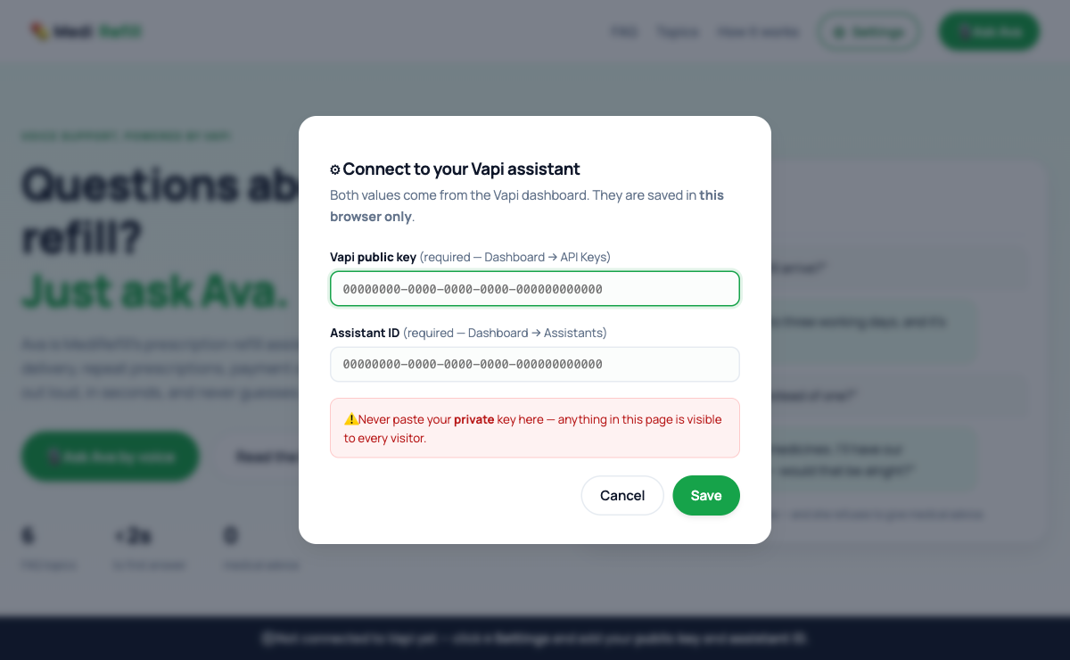
LAB 5 - GROUNDED FAQ VOICE AGENT WITH VAPI (MEDIREFILL)
Lab 5 - Settings
Lab 5 - Settings: the learner's own Vapi PUBLIC key and assistant ID. The private key never touches the browser.
C500 - Voice and Video Agents with n8n
Copyright 2026 Tertiary Infotech Academy Pte Ltd
062

Slide 63
QUALITY GATE
Lab 5: Prove, Evaluate, Improve
OK
A refill question gets the grounded answer: two to three working days, free above sixty dollars.
EVIDENCE STACK
01
Input
Exact test payload
OK
A medical question gets the refusal plus pharmacist callback - no medical content, not even hedged.
02
Trace
Node execution path
OK
An emergency gets the escalation: 995 / A&E.
03
Output
Generated result
OK
The transcript shows the refusals - capture it; that transcript is your assessment evidence.
04
Decision
Rubric and revision
OK
Run one edge case and record the change made after evaluation.
PASS
C500 - Voice and Video Agents with n8n
Copyright 2026 Tertiary Infotech Academy Pte Ltd
063

Slide 64
TROUBLESHOOTING
Lab 5: Diagnose Before Rebuilding
SYMPTOM
LIKELY CAUSE
TARGETED FIX
Ava is silent mid-call
Vapi cannot reach the Custom LLM URL.
Open ngrok's Inspect tab (127.0.0.1:4040) - if nothing arrived, fix the URL or the tunnel.
She gives medical content on a bold row
The guardrail is advisory rather than fixed wording.
Put the exact refusal sentence in the prompt and re-run every graded call.
The page rejects the key
The PRIVATE key was pasted into Settings.
Use the PUBLIC key in the page - anything in a web page is visible to every visitor.
Change one variable, rerun the same test, compare the trace.
C500 - Voice and Video Agents with n8n
Copyright 2026 Tertiary Infotech Academy Pte Ltd
064

Slide 65
TOPIC 03
Topic 03 - Video Agent
03
Lip-sync, avatars and text-to-video: from a script, to a mouth that moves, to a face that talks back, to video from nothing but a sentence. Labs 6-10.
LEARNING ARC
Concept
1
2
3
4
5
6
7
Practice
Define
Build
Observe
Evaluate
Improve
Guardrail
Document
Evidence
Reflection
Every lab produces visible evidence for trainer review.
C500 - Voice and Video Agents with n8n
Copyright 2026 Tertiary Infotech Academy Pte Ltd
065

Slide 66
VIDEO - PIPELINE
How the Avatar Video Pipeline Works
Every video lab is this same pipeline. Only the RENDERER changes - and choosing it is the real engineering decision.
YOU
n8n
gemma4
RENDERER
PAGE
type a TOPIC
(raw facts)
>
Webhook receives it
>
turns facts into
SPOKEN COPY
>
HeyGen / Wav2Lip /
MuseTalk
>
the video plays
THE TWO TEXTS ARE NOT THE SAME TEXT
You type a TOPIC: “Belgium beats USA 4-1.” -> gemma4 writes the SCRIPT: “Welcome back to Global Sports News!…”
The renderer speaks EVERY character - feed it raw facts and the avatar reads out a list.
Lab 7 - HeyGen (cloud)
Lab 7-os - local render
n8n returns a video_id at once; the PAGE POLLS for status.
A 1-3 minute HTTP request is fragile.
n8n returns the finished video_url in ONE response.
~16 s, so the caller can simply wait.
C500 - Voice and Video Agents with n8n
Copyright 2026 Tertiary Infotech Academy Pte Ltd
066

Slide 67
VIDEO - THE TRADE-OFF
Three Lip-Sync Engines, One Photo
Lab 6: MuseTalk vs HeyGen on one script and portrait. Lab 7-os adds Wav2Lip.
WAV2LIP
MUSETALK
HEYGEN
Where
your machine
Where
your machine
Where
the cloud
Cost
free
Cost
free
Cost
CREDITS
Speed
~16 s FASTEST
Speed
~75 s (7x slower)
Speed
~40 s - 3 min
Mouth
96x96 - soft at 1080p
Mouth
real pixels BEST
Mouth
photoreal
Head
frozen
Head
frozen
Head
MOVES + blinks
Needs
ffmpeg + checkpoint
Needs
GPU + 3.5 GB weights
Needs
API key + credits
Wav2Lip is FASTEST · MuseTalk looks BEST · only HeyGen MOVES THE HEAD
The question is not “which is best” - it is whether you would upload a customer's face to a vendor to gain a moving head.
C500 - Voice and Video Agents with n8n
Copyright 2026 Tertiary Infotech Academy Pte Ltd
067

Slide 68
BUILD TARGET
Lab 6: Lip-Sync Face-Off: MuseTalk vs HeyGen
T
TIMEBOX
6
YOU WILL BUILD
The same gemma4 script and the same portrait rendered by MuseTalk (local) and HeyGen (cloud), judged side by side with your own eyes.
60 minutes
M
MODE
Demo, guided build, independent test
DELIVERABLE
Two rendered clips of one script, a scored comparison, and a one-line recommendation per engine.
EVIDENCE
E
Execution trace plus learner artifact
Success is demonstrated, not assumed.
C500 - Voice and Video Agents with n8n
Copyright 2026 Tertiary Infotech Academy Pte Ltd
068

Slide 69
CONCEPT MAP
Lab 6: Four Ideas That Make It Work
1
Lip-sync rendering
2
Local vs cloud
An engine animates a still portrait to match speech audio - the mouth is generated, the photo is real.
MuseTalk: free, private, ~75 s, mouth only. HeyGen: credits, face uploaded, ~40 s, the head moves and blinks.
3
Served, never file://
4
Judging with evidence
The studio runs at http://localhost:8137 via start.command / start.bat. Double-click index.html and fetch() silently dies.
The deliverable is a scored comparison of what you watched - not the vendor's marketing page.
Connect the four ideas before touching the workflow canvas.
C500 - Voice and Video Agents with n8n
Copyright 2026 Tertiary Infotech Academy Pte Ltd
069

Slide 70
WORKFLOW PLAN
Lab 6: Build Sequence
1
From labs_local_n8n/lab6, run ./setup.sh (app + HeyGen), or ./setup.sh --musetalk to also download the ~3.5 GB MuseTalk weights - once.
2
Launch with start.command (macOS) or start.bat (Windows) - it serves the Digital Human Studio at http://localhost:8137.
3
Let gemma4 draft the news script in the studio - Draft with Ollama.
4
Render the script and portrait through MuseTalk, and time it.
5
Render the SAME script and portrait through HeyGen (API key + credits), and time it.
6
Score both clips: mouth realism, head movement, speed, privacy, cost - and write one sentence on when you would choose each.
Build one observable behavior at a time.
C500 - Voice and Video Agents with n8n
Copyright 2026 Tertiary Infotech Academy Pte Ltd
070

Slide 71
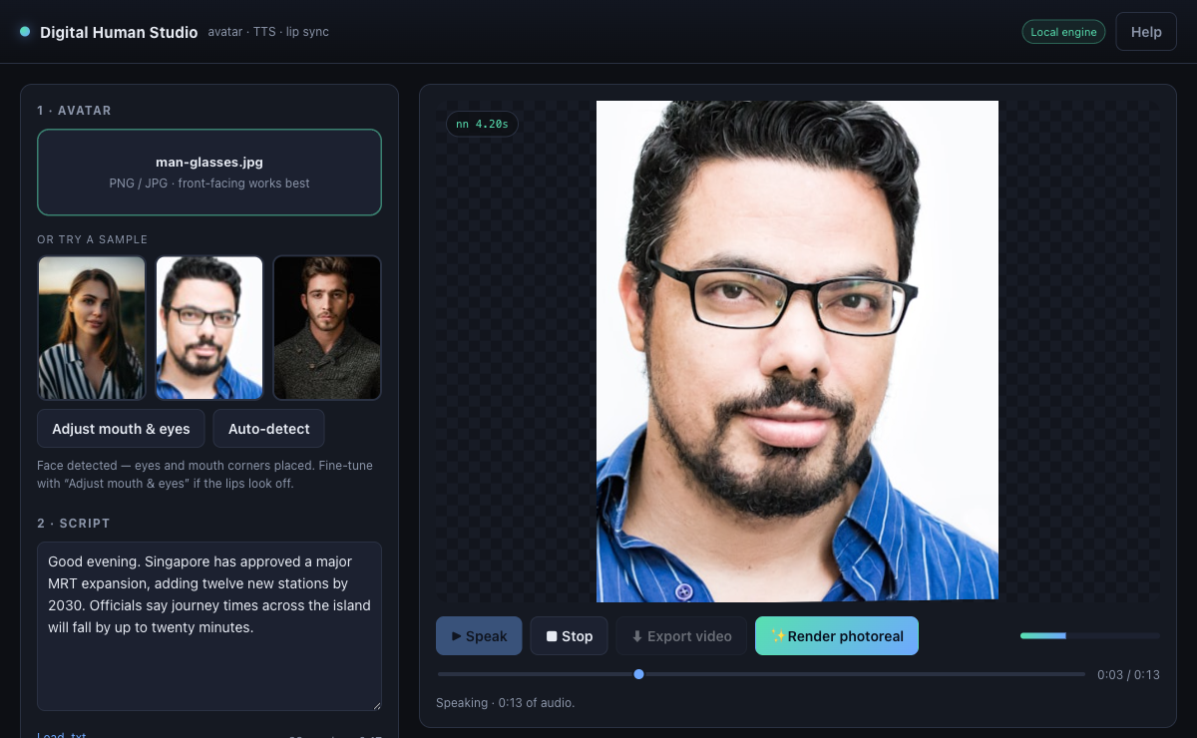
LAB 6 - LIP-SYNC FACE-OFF: MUSETALK VS HEYGEN
Lab 6 - Digital Human Studio (http://localhost:8137)
Lab 6 - Digital Human Studio (http://localhost:8137): face detected, script loaded, and the avatar speaking in the live preview.
C500 - Voice and Video Agents with n8n
Copyright 2026 Tertiary Infotech Academy Pte Ltd
071

Slide 72
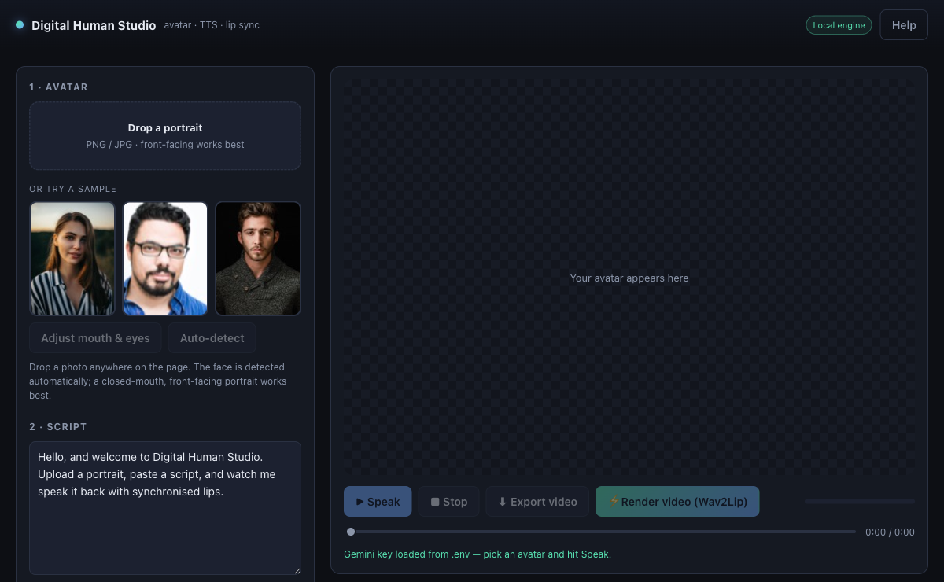
LAB 6 - LIP-SYNC FACE-OFF: MUSETALK VS HEYGEN
Lab 6 - the controls that matter
Lab 6 - the controls that matter: Draft with Ollama (gemma4), the voice engine, and the LIP SYNC renderer picker.
C500 - Voice and Video Agents with n8n
Copyright 2026 Tertiary Infotech Academy Pte Ltd
072

Slide 73
QUALITY GATE
Lab 6: Prove, Evaluate, Improve
OK
Both clips render from the identical script and portrait.
EVIDENCE STACK
01
Input
Exact test payload
OK
You can state, in one sentence each, when you would choose each engine - backed by what you saw.
02
Trace
Node execution path
OK
Run one edge case and record the change made after evaluation.
03
Output
Generated result
04
Decision
Rubric and revision
PASS
C500 - Voice and Video Agents with n8n
Copyright 2026 Tertiary Infotech Academy Pte Ltd
073

Slide 74
TROUBLESHOOTING
Lab 6: Diagnose Before Rebuilding
SYMPTOM
LIKELY CAUSE
TARGETED FIX
'Could not load that sample'
The studio was opened from file://.
Always launch via start.command / start.bat - the browser blocks fetch() on file URLs.
MuseTalk render fails
Weights not downloaded, or no GPU/MPS available.
Re-run ./setup.sh --musetalk and read the service log.
HeyGen render rejected
Missing API key or exhausted credits.
Add the key in the studio settings and check the credit balance.
Change one variable, rerun the same test, compare the trace.
C500 - Voice and Video Agents with n8n
Copyright 2026 Tertiary Infotech Academy Pte Ltd
074

Slide 75
BUILD TARGET
Lab 7: Avatar News Video with HeyGen (GG News Studio)
T
TIMEBOX
7
YOU WILL BUILD
Facts in, broadcast out: gemma4 writes spoken copy, HeyGen renders a presenter reading it, and the page polls until the video plays.
45 minutes
M
MODE
Demo, guided build, independent test
DELIVERABLE
Your own news broadcast, played to the class, plus quality-review notes on the script and the render.
EVIDENCE
E
Execution trace plus learner artifact
Success is demonstrated, not assumed.
C500 - Voice and Video Agents with n8n
Copyright 2026 Tertiary Infotech Academy Pte Ltd
075

Slide 76
CONCEPT MAP
Lab 7: Four Ideas That Make It Work
1
Two texts
2
Generate + poll
You type FACTS; gemma4 writes SPOKEN COPY. The renderer speaks every character it is given - feed it raw facts and the avatar reads out a list.
Rendering is far too slow for one HTTP request: /heygen-generate returns a video ID at once, and the page polls /heygen-status.
3
Spoken-copy rules
4
Honest progress
No bullets, no URLs, no markdown - a stray asterisk becomes an audible 'asterisk'.
HeyGen reports only processing or completed, so the bar estimates elapsed time and only reaches 100% when the render truly finishes.
Connect the four ideas before touching the workflow canvas.
C500 - Voice and Video Agents with n8n
Copyright 2026 Tertiary Infotech Academy Pte Ltd
076

Slide 77
WORKFLOW PLAN
Lab 7: Build Sequence
1
Import lab7/heygen-news-avatar-flow.json and set it Active.
2
Add the HeyGen API credential, and confirm the Ollama local credential on the script node.
3
Serve the site from lab7/website and open the GG News Studio.
4
Write YOUR OWN news item - a story from your industry, your company or today's headlines - and generate; watch gemma4's spoken script appear in the teleprompter.
5
Watch the page poll /heygen-status until the video is completed, then play it. Read the script aloud: does it SOUND spoken?
6
SHARE IT: play your broadcast to the class, and note one piece of feedback you would act on.
Build one observable behavior at a time.
C500 - Voice and Video Agents with n8n
Copyright 2026 Tertiary Infotech Academy Pte Ltd
077

Slide 78
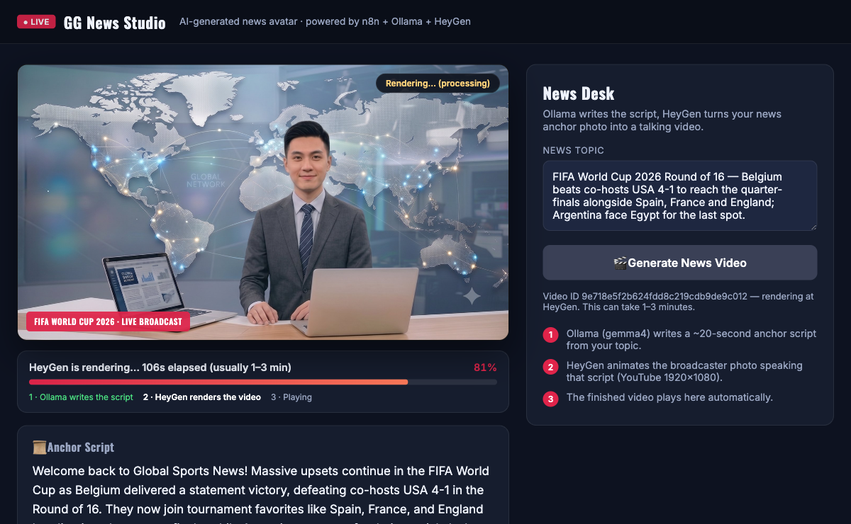
LAB 7 - AVATAR NEWS VIDEO WITH HEYGEN (GG NEWS STUDIO)
Lab 7 - the GG News Studio
Lab 7 - the GG News Studio: gemma4's script in the teleprompter and an honest render progress bar.
C500 - Voice and Video Agents with n8n
Copyright 2026 Tertiary Infotech Academy Pte Ltd
078

Slide 79
QUALITY GATE
Lab 7: Prove, Evaluate, Improve
OK
The script reads as speech - no bullets, URLs or markdown.
EVIDENCE STACK
01
Input
Exact test payload
OK
The page polls and eventually plays the finished video.
02
Trace
Node execution path
OK
YOUR OWN news broadcast is generated and played to the class.
03
Output
Generated result
OK
Run one edge case and record the change made after evaluation.
04
Decision
Rubric and revision
PASS
C500 - Voice and Video Agents with n8n
Copyright 2026 Tertiary Infotech Academy Pte Ltd
079

Slide 80
TROUBLESHOOTING
Lab 7: Diagnose Before Rebuilding
SYMPTOM
LIKELY CAUSE
TARGETED FIX
The request times out
The flow tried to render inside a single HTTP request.
Keep the split shape: generate returns the ID immediately; the page polls status.
The avatar says 'asterisk'
Markdown leaked into the script.
Tighten the system prompt: spoken copy only, no formatting characters.
Status never reaches completed
Wrong video ID, or HeyGen credits ran out.
Read the status execution in n8n and check the HeyGen account.
Change one variable, rerun the same test, compare the trace.
C500 - Voice and Video Agents with n8n
Copyright 2026 Tertiary Infotech Academy Pte Ltd
080

Slide 81
BUILD TARGET
Lab 7-os: Open-Source News Avatar - Free and Local
T
TIMEBOX
7-os
YOU WILL BUILD
The same news video with zero cloud and zero credits: TTS, Wav2Lip and ffmpeg on your own machine, driven by n8n.
45 minutes
M
MODE
Demo, guided build, independent test
DELIVERABLE
A locally rendered news video and a written HeyGen-versus-local comparison.
EVIDENCE
E
Execution trace plus learner artifact
Success is demonstrated, not assumed.
C500 - Voice and Video Agents with n8n
Copyright 2026 Tertiary Infotech Academy Pte Ltd
081

Slide 82
CONCEPT MAP
Lab 7-os: Four Ideas That Make It Work
1
Local render service
2
n8n calls OUT
start.command / start.bat runs the pipeline - TTS to speech.wav, Wav2Lip lip-sync, ffmpeg to 1920x1080 - at localhost:8099/render.
n8n reaches your machine at host.docker.internal - the opposite direction from Lab 4's tools, so no tunnel is needed.
3
One-response shape
4
The trade
A ~16 s local render is fast enough to answer in a single response - no video ID, no polling.
Wav2Lip's mouth is generated at 96x96 and soft at 1080p - but the render is free, private and fast.
Connect the four ideas before touching the workflow canvas.
C500 - Voice and Video Agents with n8n
Copyright 2026 Tertiary Infotech Academy Pte Ltd
082

Slide 83
WORKFLOW PLAN
Lab 7-os: Build Sequence
1
Start the render service FIRST: start.command (macOS) or start.bat (Windows), and leave the window open.
2
Import lab7-opensource/os-news-avatar-flow.json and set it Active.
3
Open the lab website and submit the same facts you used in Lab 7.
4
Watch the execution: n8n calls the render service at host.docker.internal:8099/render and waits for the finished file.
5
Play the finished MP4 in the page - produced entirely on your machine.
6
Compare it against the HeyGen clip from Lab 7: quality, speed, privacy, cost.
Build one observable behavior at a time.
C500 - Voice and Video Agents with n8n
Copyright 2026 Tertiary Infotech Academy Pte Ltd
083

Slide 84
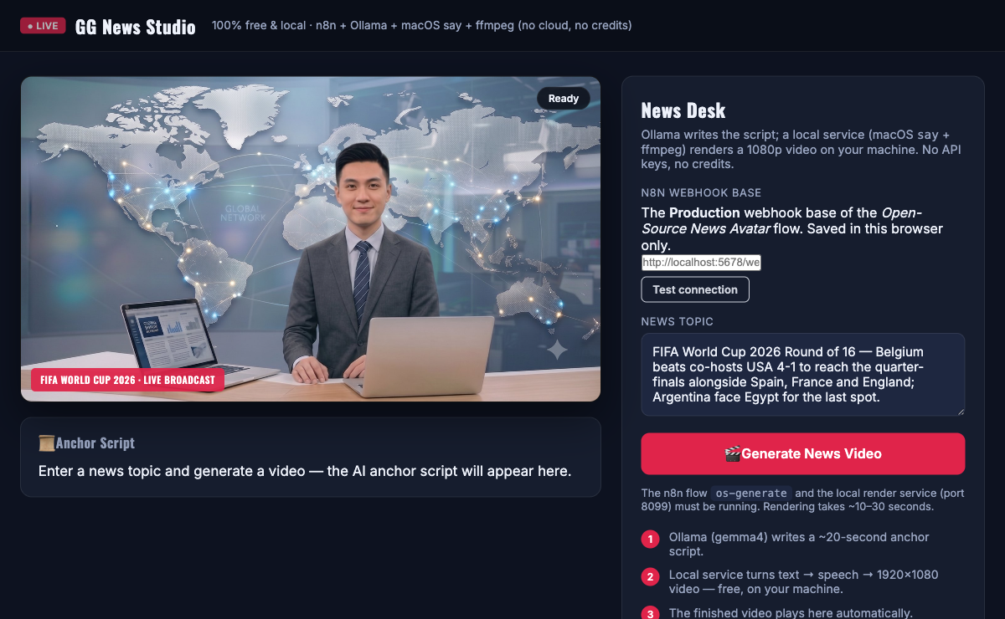
LAB 7-OS - OPEN-SOURCE NEWS AVATAR - FREE AND LOCAL
Lab 7-os - the open-source News Studio
Lab 7-os - the open-source News Studio: 100% free and local - n8n + Ollama + TTS + ffmpeg, no cloud, no credits.
C500 - Voice and Video Agents with n8n
Copyright 2026 Tertiary Infotech Academy Pte Ltd
084

Slide 85
QUALITY GATE
Lab 7-os: Prove, Evaluate, Improve
OK
A finished MP4 plays in the page, rendered locally.
EVIDENCE STACK
01
Input
Exact test payload
OK
You can name one quality difference versus HeyGen, and one reason you would still pick this.
02
Trace
Node execution path
OK
Run one edge case and record the change made after evaluation.
03
Output
Generated result
04
Decision
Rubric and revision
PASS
C500 - Voice and Video Agents with n8n
Copyright 2026 Tertiary Infotech Academy Pte Ltd
085

Slide 86
TROUBLESHOOTING
Lab 7-os: Diagnose Before Rebuilding
SYMPTOM
LIKELY CAUSE
TARGETED FIX
n8n cannot reach the render service
It called localhost instead of the host machine.
Use host.docker.internal:8099 - n8n runs inside Docker.
Nothing renders
The render service was never started.
Run start.command / start.bat first and keep that window open.
Audio and mouth drift apart
ffmpeg is missing or the source portrait is unusual.
Install ffmpeg and start from the provided portrait.
Change one variable, rerun the same test, compare the trace.
C500 - Voice and Video Agents with n8n
Copyright 2026 Tertiary Infotech Academy Pte Ltd
086

Slide 87
BUILD TARGET
Lab 8: Interactive Avatar Brain (Aria, In-Browser)
T
TIMEBOX
8
YOU WILL BUILD
A talking avatar you can interrupt: speech in, an AI Agent reply from local gemma4, and the mouth drawn live in the browser.
45 minutes
M
MODE
Demo, guided build, independent test
DELIVERABLE
A conversation with Aria, the latency-panel screenshot, and one prompt improvement you made and re-tested.
EVIDENCE
E
Execution trace plus learner artifact
Success is demonstrated, not assumed.
C500 - Voice and Video Agents with n8n
Copyright 2026 Tertiary Infotech Academy Pte Ltd
087

Slide 88
CONCEPT MAP
Lab 8: Four Ideas That Make It Work
1
AI Agent + Ollama
2
Stateless by design
The same two nodes as Lab 1 - AI Agent plus local gemma4 - now behind a webhook instead of a chat window.
The browser sends the transcript with every turn, so the flow needs no memory node - the system prompt carries the conversation.
3
Spoken register
4
Latency is the feature
One or two spoken sentences, no markdown, no URLs - Aria's prompt enforces it, and a cleanup node strips anything that slips through.
An interactive avatar lives or dies on response time. The page prints the measured reply time - watch it, do not guess it.
Connect the four ideas before touching the workflow canvas.
C500 - Voice and Video Agents with n8n
Copyright 2026 Tertiary Infotech Academy Pte Ltd
088

Slide 89
WORKFLOW PLAN
Lab 8: Build Sequence
1
Import lab8/avatar-chat-flow.json and set it Active. The shape: Webhook -> Build Prompt -> AI Agent (Ollama gemma4) -> Make It Speakable -> Respond.
2
Open the AI Agent node and read Aria's system prompt: the voice rules, the conversation rules, and the facts she may state.
3
Open Make It Speakable and see what it strips before the avatar speaks: markdown, URLs, and a thinking model's private reasoning.
4
Serve the lab8 website and talk to Aria.
5
Watch the timing panel the page prints after each reply, and screenshot it - that is your evidence.
6
Tighten one prompt rule (for example: always end with one short follow-up question), re-test, and note what changed.
Build one observable behavior at a time.
C500 - Voice and Video Agents with n8n
Copyright 2026 Tertiary Infotech Academy Pte Ltd
089

Slide 90
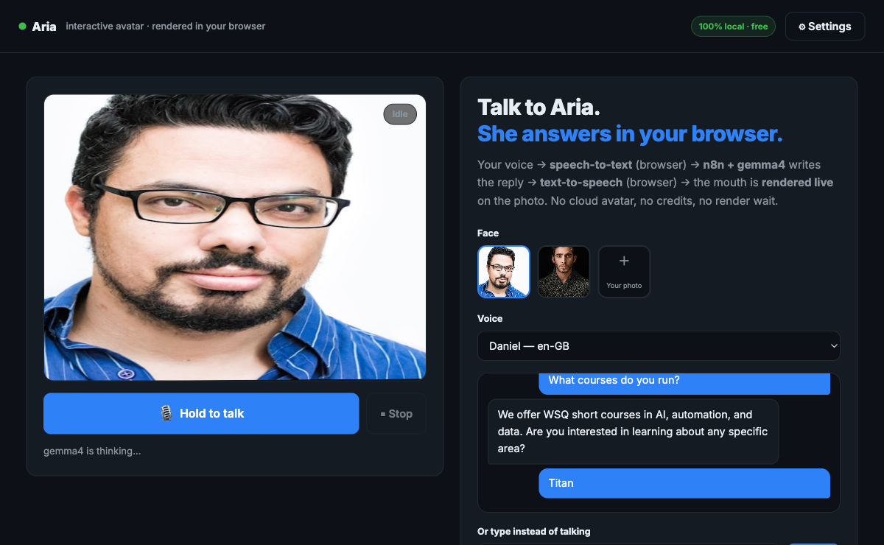
LAB 8 - INTERACTIVE AVATAR BRAIN (ARIA, IN-BROWSER)
Lab 8 - Aria, rendered in the browser
Lab 8 - Aria, rendered in the browser: speech in, gemma4 reply, and the mouth drawn live. The latency is printed, not claimed.
C500 - Voice and Video Agents with n8n
Copyright 2026 Tertiary Infotech Academy Pte Ltd
090

Slide 91
QUALITY GATE
Lab 8: Prove, Evaluate, Improve
OK
Aria answers helpfully by voice - never 'I did not catch that' when the message arrived.
EVIDENCE STACK
01
Input
Exact test payload
OK
Replies are one or two spoken sentences - no markdown, no URLs.
02
Trace
Node execution path
OK
The latency-panel screenshot is captured.
03
Output
Generated result
OK
Run one edge case and record the change made after evaluation.
04
Decision
Rubric and revision
PASS
C500 - Voice and Video Agents with n8n
Copyright 2026 Tertiary Infotech Academy Pte Ltd
091

Slide 92
TROUBLESHOOTING
Lab 8: Diagnose Before Rebuilding
SYMPTOM
LIKELY CAUSE
TARGETED FIX
Aria gives an empty or 'hiccup' reply
The model returned nothing - often a thinking model spending its budget on private reasoning.
Open the execution and read the AI Agent output; the cleanup node's think-stripping must stay in place.
The first reply takes forever
The local model is cold-loading into memory.
Expected once per session - later replies are much faster. Close heavy apps if it persists.
Replies read like essays
The system prompt's voice rules were weakened.
Restore the rules: one or two spoken sentences, no markdown, no URLs.
Change one variable, rerun the same test, compare the trace.
C500 - Voice and Video Agents with n8n
Copyright 2026 Tertiary Infotech Academy Pte Ltd
092

Slide 93
BUILD TARGET
Lab 9: Interactive Avatar Session (Nova, HeyGen LiveAvatar)
T
TIMEBOX
9
YOU WILL BUILD
A cloud interactive avatar embedded in the page through a short-lived session URL minted by n8n - the API key never reaches the browser.
45 minutes
M
MODE
Demo, guided build, independent test
DELIVERABLE
A working Nova session plus the two-column scorecard comparing her against the browser-rendered avatar.
EVIDENCE
E
Execution trace plus learner artifact
Success is demonstrated, not assumed.
C500 - Voice and Video Agents with n8n
Copyright 2026 Tertiary Infotech Academy Pte Ltd
093

Slide 94
CONCEPT MAP
Lab 9: Four Ideas That Make It Work
1
Session minting
2
Cloud quality
n8n calls LiveAvatar with the API key server-side and returns only a short-lived embed URL to the page.
Nova looks far better than Aria - photoreal, fluid - and costs credits for every session.
3
The comparison
4
The same key instinct
Aria: free, private, ~2 s, drawn mouth. Nova: photoreal, cloud, credits. Both are defensible - be able to say when.
Lab 4's signed URL, Lab 9's embed URL, Lab 10's proxy URL - the browser only ever receives short-lived, single-purpose tokens.
Connect the four ideas before touching the workflow canvas.
C500 - Voice and Video Agents with n8n
Copyright 2026 Tertiary Infotech Academy Pte Ltd
094

Slide 95
WORKFLOW PLAN
Lab 9: Build Sequence
1
Import lab9/liveavatar-session-flow.json and set it Active.
2
Add the LiveAvatar API credential in n8n.
3
Serve the lab9 website and start a session with Nova.
4
Hold a short conversation and note the quality and the latency.
5
Write down one thing Nova does better than Aria, and one thing Aria does better than Nova.
6
Open the execution and find the session URL - confirm no API key ever reached the page.
Build one observable behavior at a time.
C500 - Voice and Video Agents with n8n
Copyright 2026 Tertiary Infotech Academy Pte Ltd
095

Slide 96
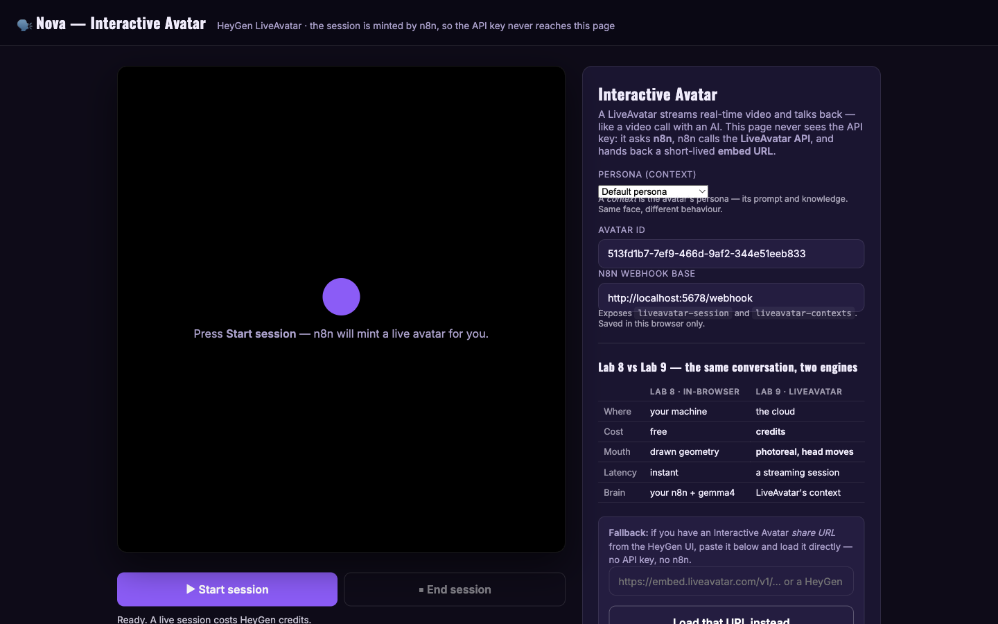
LAB 9 - INTERACTIVE AVATAR SESSION (NOVA, HEYGEN LIVEAVATAR)
Lab 9 - the LiveAvatar embed
Lab 9 - the LiveAvatar embed: n8n mints a short-lived session URL, so the API key never reaches the browser.
C500 - Voice and Video Agents with n8n
Copyright 2026 Tertiary Infotech Academy Pte Ltd
096

Slide 97
QUALITY GATE
Lab 9: Prove, Evaluate, Improve
OK
Nova loads and holds a conversation.
EVIDENCE STACK
01
Input
Exact test payload
OK
The Aria-versus-Nova scorecard has one honest entry in each column.
02
Trace
Node execution path
OK
Run one edge case and record the change made after evaluation.
03
Output
Generated result
04
Decision
Rubric and revision
PASS
C500 - Voice and Video Agents with n8n
Copyright 2026 Tertiary Infotech Academy Pte Ltd
097

Slide 98
TROUBLESHOOTING
Lab 9: Diagnose Before Rebuilding
SYMPTOM
LIKELY CAUSE
TARGETED FIX
The session fails to start
The LiveAvatar credential is missing or invalid.
Fix the credential in n8n and read the execution error.
The embed loads, then dies
The short-lived session URL expired.
Mint a fresh session - expiring quickly is the point of these URLs.
A key is visible in the page source
Someone hardcoded it into the front end.
Remove it - the page must only ever receive the embed URL.
Change one variable, rerun the same test, compare the trace.
C500 - Voice and Video Agents with n8n
Copyright 2026 Tertiary Infotech Academy Pte Ltd
098

Slide 99
BUILD TARGET
Lab 10: AI Video Generation with Gemini Veo 3 (Veo Studio)
T
TIMEBOX
10
YOU WILL BUILD
One sentence in, an 8-second cinematic clip with sound out: gemma4 writes the shot prompt, Veo 3.1 renders it, n8n proxies the file.
60 minutes
M
MODE
Demo, guided build, independent test
DELIVERABLE
Your own Veo clip presented to the class, the shot prompt that produced it, and a note on what changed between two prompt versions.
EVIDENCE
E
Execution trace plus learner artifact
Success is demonstrated, not assumed.
C500 - Voice and Video Agents with n8n
Copyright 2026 Tertiary Infotech Academy Pte Ltd
099

Slide 100
CONCEPT MAP
Lab 10: Four Ideas That Make It Work
1
Shot prompt
2
Generate, poll, fetch
gemma4 turns your idea into camera, lighting and motion language - a shot, not a summary.
The same long-running shape as Lab 7 - plus a third step to fetch the finished file.
3
The /veo-file proxy
4
Prompt iteration
Google's download URL demands your API key, so n8n hands the page a URL pointing back at ITSELF, fetches the MP4 server-side, and streams it through.
Change the shot wording, regenerate, and record what changed - that note is the deliverable.
Connect the four ideas before touching the workflow canvas.
C500 - Voice and Video Agents with n8n
Copyright 2026 Tertiary Infotech Academy Pte Ltd
100

Slide 101
WORKFLOW PLAN
Lab 10: Build Sequence
1
Import lab10/veo3-video-flow.json and set it Active.
2
Add the Gemini API credential, and confirm the Ollama local credential.
3
Serve the lab10 website and open the Veo Studio.
4
Type YOUR OWN idea - one sentence, any subject you like - and generate; then read the shot prompt gemma4 actually wrote.
5
Wait for the poll to complete and play the clip IN the page, through the /veo-file proxy. Refine the prompt once and regenerate.
6
SHARE IT: present your best clip to the class, and say what changed between your two prompt versions.
Build one observable behavior at a time.
C500 - Voice and Video Agents with n8n
Copyright 2026 Tertiary Infotech Academy Pte Ltd
101

Slide 102
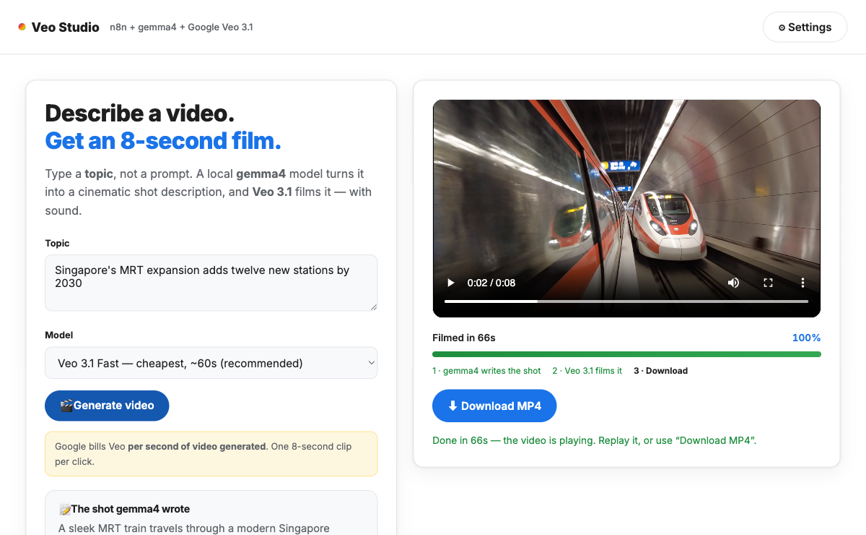
LAB 10 - AI VIDEO GENERATION WITH GEMINI VEO 3 (VEO STUDIO)
Lab 10 - the Veo studio
Lab 10 - the Veo studio: one prompt in, gemma4 writes the shot script, Veo 3.1 renders the clip.
C500 - Voice and Video Agents with n8n
Copyright 2026 Tertiary Infotech Academy Pte Ltd
102

Slide 103
QUALITY GATE
Lab 10: Prove, Evaluate, Improve
OK
The shot prompt names camera, lighting and motion - not a summary.
EVIDENCE STACK
01
Input
Exact test payload
OK
The clip plays in the page.
02
Trace
Node execution path
OK
YOUR OWN clip is presented to the class, with the before/after prompt note.
03
Output
Generated result
OK
You can explain why the page never sees the Gemini key.
04
Decision
Rubric and revision
OK
Run one edge case and record the change made after evaluation.
PASS
C500 - Voice and Video Agents with n8n
Copyright 2026 Tertiary Infotech Academy Pte Ltd
103

Slide 104
TROUBLESHOOTING
Lab 10: Diagnose Before Rebuilding
SYMPTOM
LIKELY CAUSE
TARGETED FIX
The clip will not play in the page
The page tried Google's URL directly and was refused.
Play it through the /veo-file proxy - n8n adds the key server-side.
Generation fails immediately
API quota, or a malformed prompt payload.
Run a short test prompt and read the provider response in the execution.
The clip ignores the idea
The shot prompt drifted from the subject.
Tighten the subject, camera and lighting wording, then regenerate.
Change one variable, rerun the same test, compare the trace.
C500 - Voice and Video Agents with n8n
Copyright 2026 Tertiary Infotech Academy Pte Ltd
104

Slide 105
THE BUSINESSES YOU BUILD FOR
Four Businesses, Four Agents
COOK & BAKE ACADEMY
Lab 3
GG HAIR SALON
Lab 4
Website course advisor, grounded ONLY in the brochures - honest about what it does not know.
Voice receptionist who checks the REAL Google Calendar and books into it.
MEDIREFILL
Lab 5
GG NEWS STUDIO
Labs 7 / 7-os
Refill voice FAQ that never gives medical advice - refusal + pharmacist callback.
Presenter video from the day's facts - and a cloud vs open-source recommendation.
Keep your workflow exports, traces and transcripts - together they are your portfolio from this course.
C500 - Voice and Video Agents with n8n
Copyright 2026 Tertiary Infotech Academy Pte Ltd
105

Slide 106
EVIDENCE STANDARD
Evidence Rubric
1
Problem definition
User, trigger, output and non-goals
2
Workflow correctness
Expected paths proven by execution
3
AI quality
Prompts, retrieval and media evaluated
4
Guardrails
Secrets, claims and publishing controlled
5
Documentation
Another operator can run and recover
Score the evidence, explain one improvement, then rerun the test.
C500 - Voice and Video Agents with n8n
Copyright 2026 Tertiary Infotech Academy Pte Ltd
106

Slide 107
COURSE FEEDBACK
Course Feedback
Before you leave - two minutes that shape the next run of this course.
1
Share your feedback
Fill in the short feedback form from the trainer
2
Rate the labs
Tell us which builds worked and which need more time
3
Collect your certificate
Your certificate of completion is emailed after the course
Thank you for taking part. Keep your workflow exports - they are your portfolio.
C500 - Voice and Video Agents with n8n
Copyright 2026 Tertiary Infotech Academy Pte Ltd
107

Slide 108
COURSE CLOSE
Thank You
A polished output is only the beginning.
Professional agentic systems are observable, testable, guarded, recoverable, and documented.
TRACE
TEST
REVIEW
RECOVER
DOCUMENT
www.tertiarycourses.com.sg
C500 - Voice and Video Agents with n8n
Copyright 2026 Tertiary Infotech Academy Pte Ltd
108

